Slide 1

Task: Squircle Task
In this task you will be presented with 8 circles varying in between red and blue colors.
We would like to ask you to choose whether average color overall circles tends to be more blue or red.
Please, try to be as fast as possible while trying to give the correct answers.
First block will have feedback on the correctness of the given answer. Wrong or Correct
How to answer for each trial: You will see an example of stimuli in the next page. You can click on “spacebar”
Spacebar
Press to in order to continue
Notes:
1

Slide 2
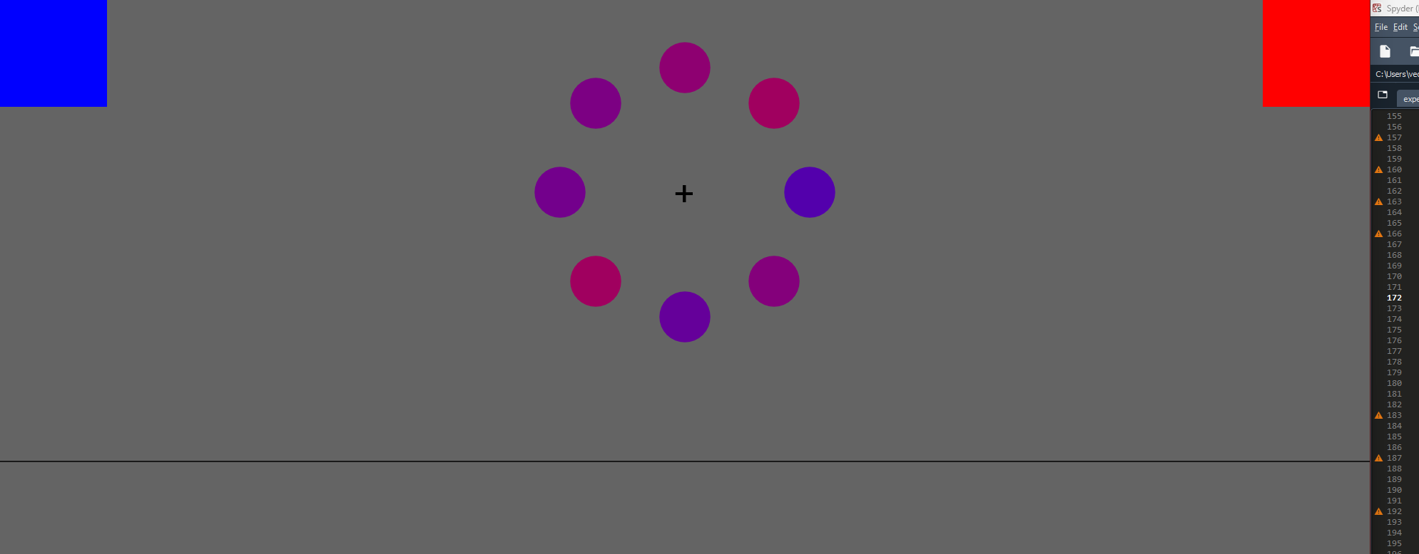
Task: Squircle Task
As you will see the stimuli for a brief time, you will choose your decision by moving your cursor to either blue or red box.
You do not need to click on the box after you move your cursor
After some time, cursor will move back to the original position and next trial will start.
Please press spacebar after you understand the instructions and start with training
Press the above-mentioned keys to respond:
First 40 trial will have feedback on the correctness of the given answer.
This procedure should take around XX – XX minutes.
You can click on “spacebar” whenever you are ready, and the procedure will begin.
Spacebar
Press to in order to continue
Press to in order to continue
Notes:
1

Slide 3
Break Time!
Break out of
Your Average Accuracy
Your Average reaction time
Press to in order to continue

Slide 4
Break Time!
Break :
Out of 9 breaks
Your Average Accuracy
Your Average reaction time
Press to in order to continue

Slide 5
This task has been completed and finished successfully.
Everything is now finished.
Assistant will inform you with details.
Thank you for your participation!
Press to in order to exit

